Slide 1
Data Structures and Algorithms -3 (25CS2103E)
Team Members
Ashwanth Reddy : 2520030081
M.Ram Ratan: 2520030291, M. Nishant : 2520030323
Under the Esteemed Guidance of : Professor Yamini Devi
Batch no : 12

Slide 2
Contents
Abstract
Introduction
Literature survey
Problem Statement and Objectives
Hardware and Software requirements
Results
Conclusion
Future Scope

Slide 3
Abstract
This project presents a sequence alignment tool that implements the Smith–Waterman algorithm to identify optimal local alignments between two biological sequences, such as DNA or protein strings. Unlike global alignment methods, the tool focuses on detecting highly similar subsequences embedded within larger sequences, making it well-suited for genomic similarity analysis. The system employs dynamic programming to construct a scoring matrix based on configurable parameters, including match, mismatch, and gap penalty values, and performs traceback to extract the highest-scoring local alignment. The application visualizes the aligned subsequences alongside their computed alignment score. By allowing users to adjust scoring parameters, the tool supports experimentation with different alignment sensitivities suited to varied biological contexts. This project demonstrates the practical application of dynamic programming in bioinformatics.

Slide 4
Introduction
Sequence alignment is a core technique in bioinformatics used to identify regions of similarity between DNA, RNA, or protein sequences.
Two broad approaches exist: global alignment (aligns entire sequences end-to-end) and local alignment (finds the best matching subregions).
The Smith–Waterman algorithm, introduced in 1981, is the classical dynamic programming method for optimal local sequence alignment.
Local alignment is especially useful when sequences share only partial similarity — e.g., conserved domains, motifs, or gene fragments — rather than being similar throughout.
Applications include gene identification, mutation detection, evolutionary studies, and protein structure/function prediction.
This project implements Smith–Waterman as an interactive tool with configurable scoring and visual output of the aligned regions.

Slide 5
Literature Survey
Needleman–Wunsch (1970): introduced dynamic programming for global sequence alignment; not suited for partial similarity detection.
Smith–Waterman (1981): extended the DP approach for local alignment by allowing scores to reset to zero, isolating the best-matching subsequence.
BLAST (Altschul et al., 1990): a heuristic-based tool built for speed on large databases, trading exact optimality for performance.
FASTA: another heuristic local alignment tool, faster but approximate compared to Smith–Waterman.
Existing literature establishes Smith–Waterman as the gold-standard exact method for local alignment, though computationally more expensive (O(mn) time/space) than heuristic alternatives — making it ideal for smaller sequences or accuracy-critical use cases, which this project targets.

Slide 6
Problem Statement and Objectives
Problem Statement:
Given two biological sequences, there is a need for a tool that can accurately identify the most similar local subsequences between them, rather than forcing a full end-to-end comparison, while allowing flexibility in scoring criteria and providing a clear visual representation of the result.
Objectives:
Implement the Smith–Waterman dynamic programming algorithm for optimal local alignment.
Allow configurable scoring parameters (match score, mismatch penalty, gap penalty).
Perform traceback to reconstruct and display the optimal local alignment.
Visualize the aligned subsequences and the alignment score.
Validate the tool on sample DNA/protein sequences to demonstrate correctness.

Slide 7
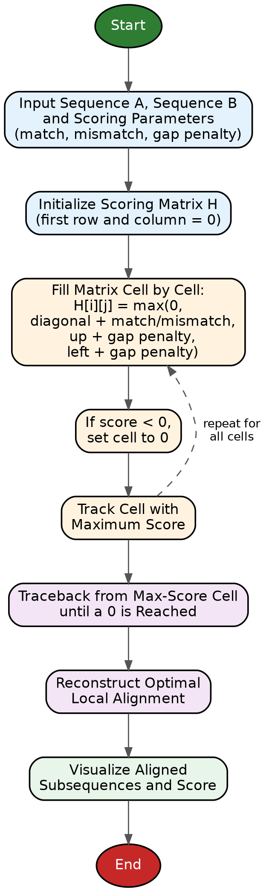
Flow Chart
Input two sequences (Sequence A, Sequence B) and scoring parameters.
Initialize scoring matrix H with zeros in the first row and column.
Fill matrix: for each cell, compute score using match/mismatch/gap rules; if score < 0, set to 0.
Track the cell with the maximum score in the matrix.
Traceback from the max-score cell until a 0 is reached, reconstructing the aligned subsequence.
Output the optimal local alignment and its score.
Visualize the aligned subsequences.

Slide 8
Results
The tool successfully computes optimal local alignments for sample sequence pairs.
Example: given two DNA sequences with a shared conserved region, the tool correctly isolates the matching subsequence and reports its alignment score.
Varying scoring parameters (match/mismatch/gap) demonstrably changes the length and boundaries of the aligned region, confirming correct algorithm behavior.
The visualization clearly highlights the aligned subsequence within the larger input sequences.

Slide 9
Hardware and Software requirements
Hardware:
Processor: Intel i3 or above
RAM: 4 GB minimum (8 GB recommended)
Storage: 500 MB free space
Software:
Operating System: Windows/Linux/macOS
Programming Language: Python / Java / C++ (whichever you implemented in)
Libraries: NumPy (matrix operations), Matplotlib/Tkinter (visualization) — adjust to your actual stack
IDE: VS Code / PyCharm / Eclipse

Slide 10
Conclusion
This project successfully implements the Smith–Waterman algorithm to perform optimal local sequence alignment between two biological sequences. The tool demonstrates how dynamic programming can be applied to identify meaningful regions of similarity even when sequences differ substantially elsewhere. With configurable scoring parameters and visual output, the application provides an accessible way to explore local similarity analysis, reinforcing the relevance of classical algorithmic techniques in modern genomics and bioinformatics research.

Slide 11
Future Scope
Extend the tool to support multiple sequence alignment (MSA) rather than pairwise alignment only.
Optimize the algorithm using space-efficient variants (e.g., Hirschberg's algorithm) for handling longer sequences.
Integrate real biological databases (e.g., NCBI, UniProt) for direct sequence retrieval.
Add support for affine gap penalties for more biologically realistic scoring.
Explore parallelization/GPU acceleration to improve performance on large-scale genomic data.

Slide 12
Thank you

